Slide 1
Jerusalem Science Contest
Molecular Biology

Slide 2
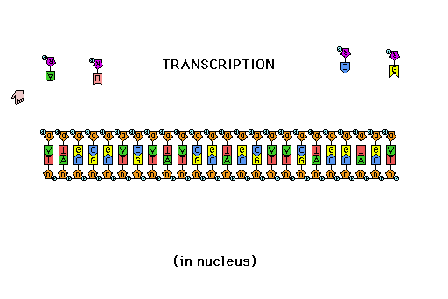
Lecture 3: RNA Transcription
Outside reading: https://kids.frontiersin.org/articles/10.3389/frym.2020.599460
Image from Steven Kuensting, CC BY-SA 4.0 <https://creativecommons.org/licenses/by-sa/4.0>, via Wikimedia Commons

Slide 3
RNA Transcription – Reading the Instructions
The DNA in each of our cells contains all of the instructions for building every protein (and some other structures) in every cell
Each cell must access the specific information needed in that cell, without risking damage to the DNA itself
This is done by making temporary RNA copies of specific instructions (genes), called messenger RNA (mRNA). via the process of transcription

Slide 4
RNA vs. DNA
RNA is a nucleic acid, like DNA, but has 3 main differences:
RNA uses ribose, DNA uses deoxyribose
Instead of thymine (T), RNA uses uracil (U)
RNA is single-stranded, DNA is double-stranded
HOH₂C
OH
HOH₂C
OH
O
O
OH
OH
OH
Ribose Deoxyribose
O
O
H₃C
NH
NH
NH
O
NH
O
Uracil Thymine

Slide 5
RNA Polymerase
DNA is transcribed (copied) into RNA by the complex enzyme RNA polymerase
RNA polymerase works very similarly to DNA polymerase, using one strand of DNA as a template to make a complementary strand of RNA
Like DNA polymerase, RNA polymerase builds in the 5’->3’ direction, but it can start a new strand all by itself

Slide 6
RNA Transcription
RNA transcription of a gene begins at a special sequence called the promoter, where RNA polymerase binds to DNA
RNA polymerase unwinds a short stretch of DNA, and begins building RNA one nucleotide at a time
promoter
RNA polymerase
DNA
RNA

Slide 7
Control of Transcription
Not all genes are transcribed at the same time, or in every cell
Each cell must have a way to control when a gene is turned “on” or “off”
Special DNA-binding proteins called transcription factors bind near the promoter, and at other specialized regions called enhancers, and they regulate the activity of RNA polymerase
This in turn regulates the timing and amount of transcription of a gene

Slide 8
RNA Processing
In bacteria, mRNA can be used as soon as it is transcribed
Eukaryotes are more complicated, and must “process” the newly synthesized RNA (called “pre-mRNA”) before it can be used
Three steps: 5’ cap addition, splicing, and 3’ tail addition

Slide 9
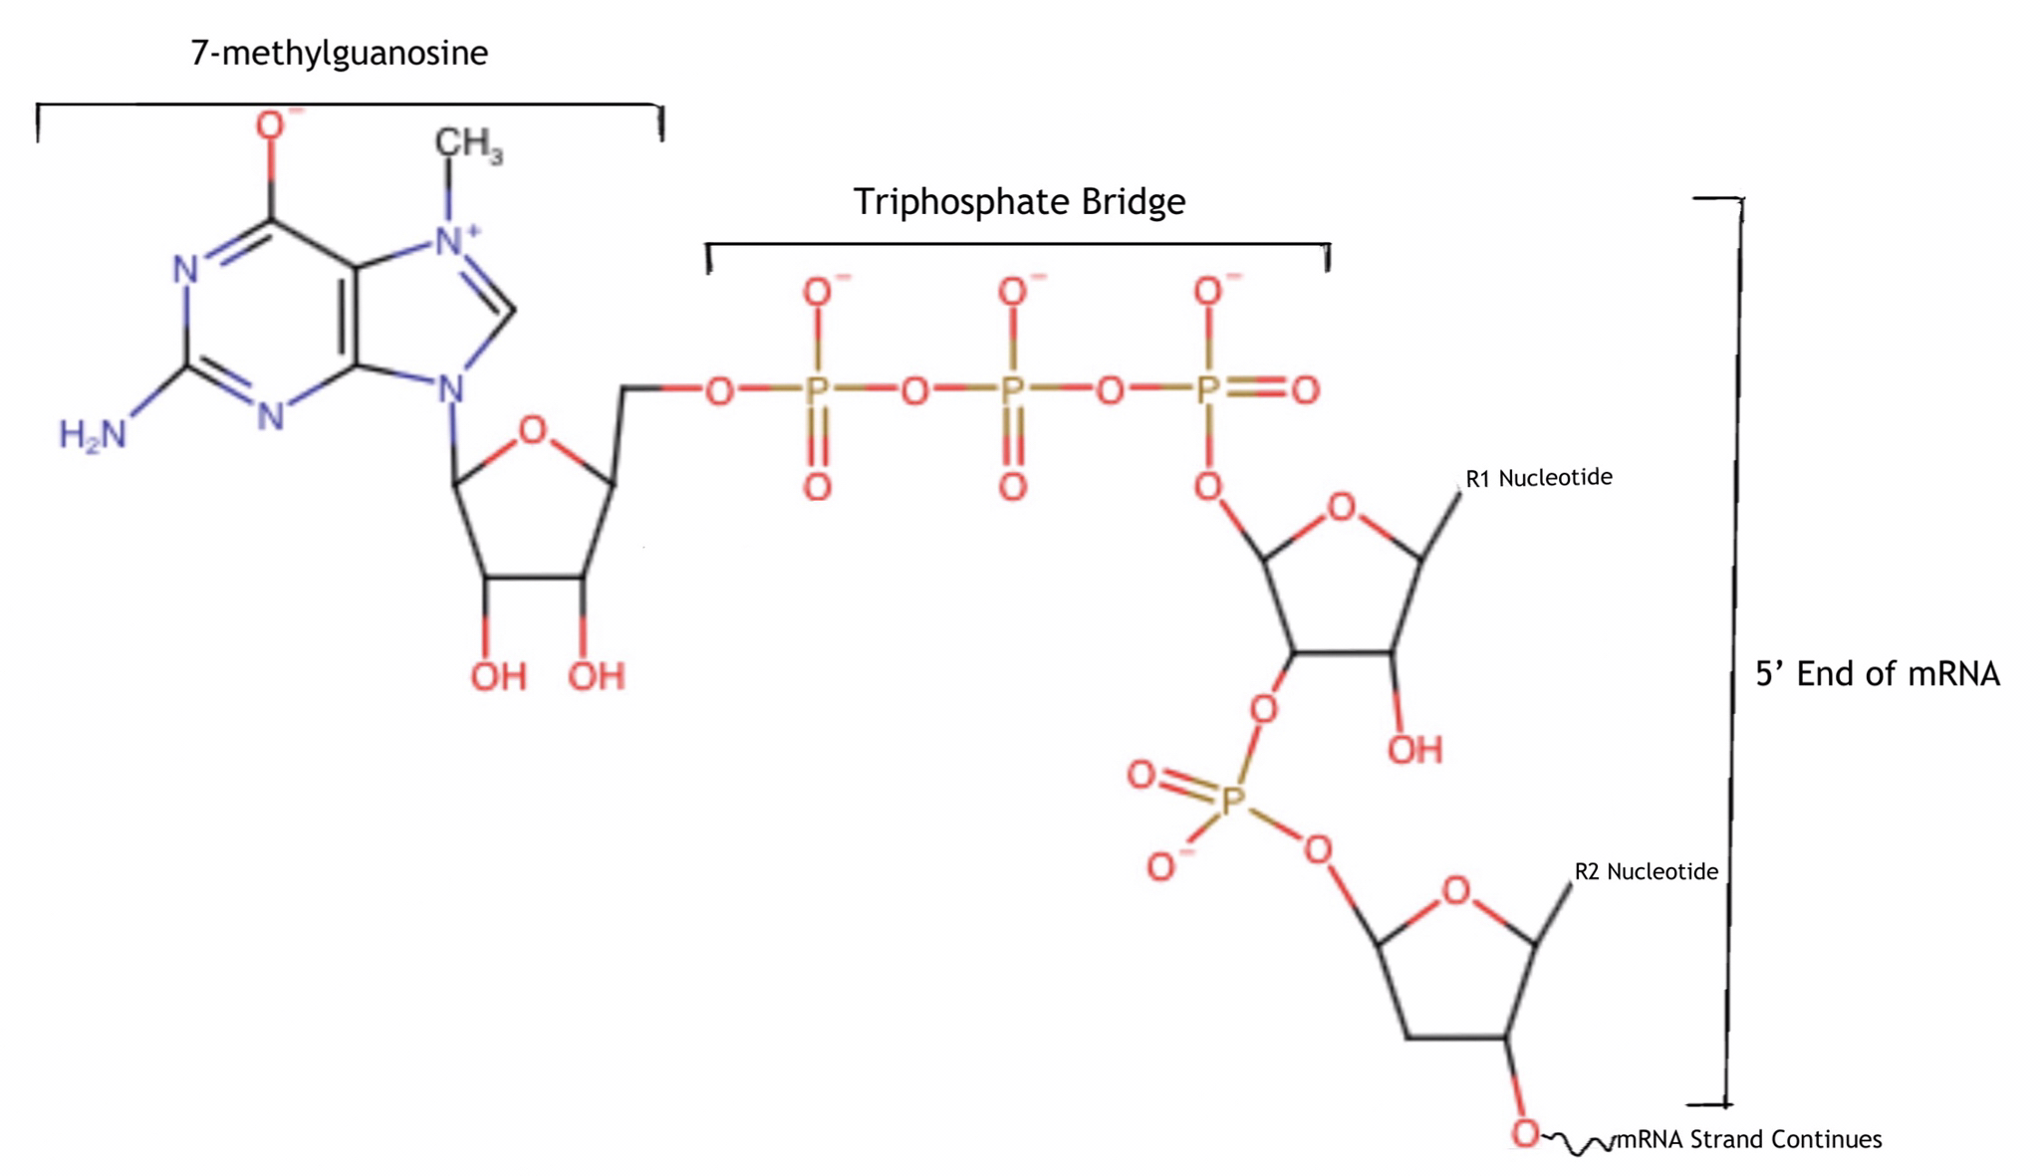
5’ Cap Addition
The first step of processing is the addition of a special structure at the 5’ end of the new RNA molecule
It uses a modified version of guanosine (7-methylguanosine) attached in an unusual way (5’-5’, triphosphate bridge) to distinguish from non-mRNA molecules
Also helps the cell to “know” that the mRNA is intact at the 5’ end
Image from ExasperatedOctopus, CC BY-SA 4.0 <https://creativecommons.org/licenses/by-sa/4.0>, via Wikimedia Commons

Slide 10
RNA Splicing
Most eukaryotic genes contain inserted sequences (called “introns”) that interrupt the coding sequences (called “exons”), and which must be removed by the process of RNA splicing
Carried out by a large complex called the spliceosome
A mRNA molecule may be spliced different ways (“alternative splicing”) to allow somewhat different proteins to be made from the same gene

Slide 11
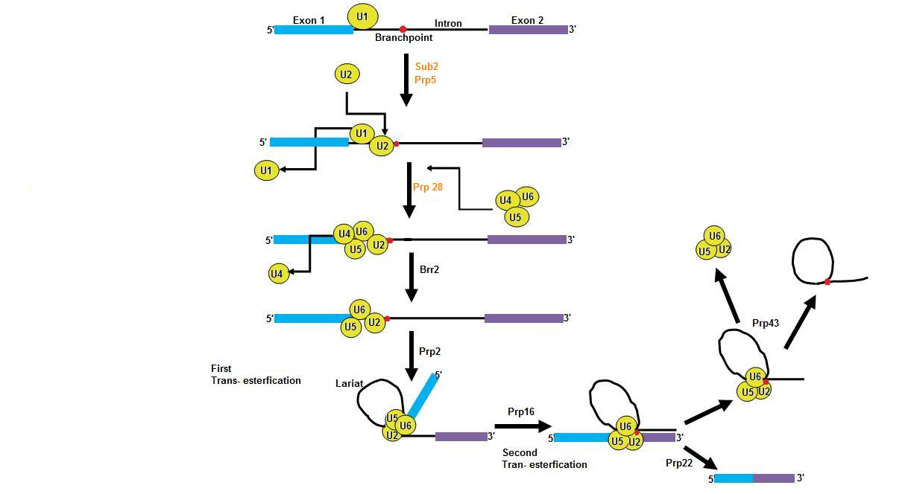
RNA Splicing
Image from Shahine4, Public domain, via Wikimedia Commons

Slide 12
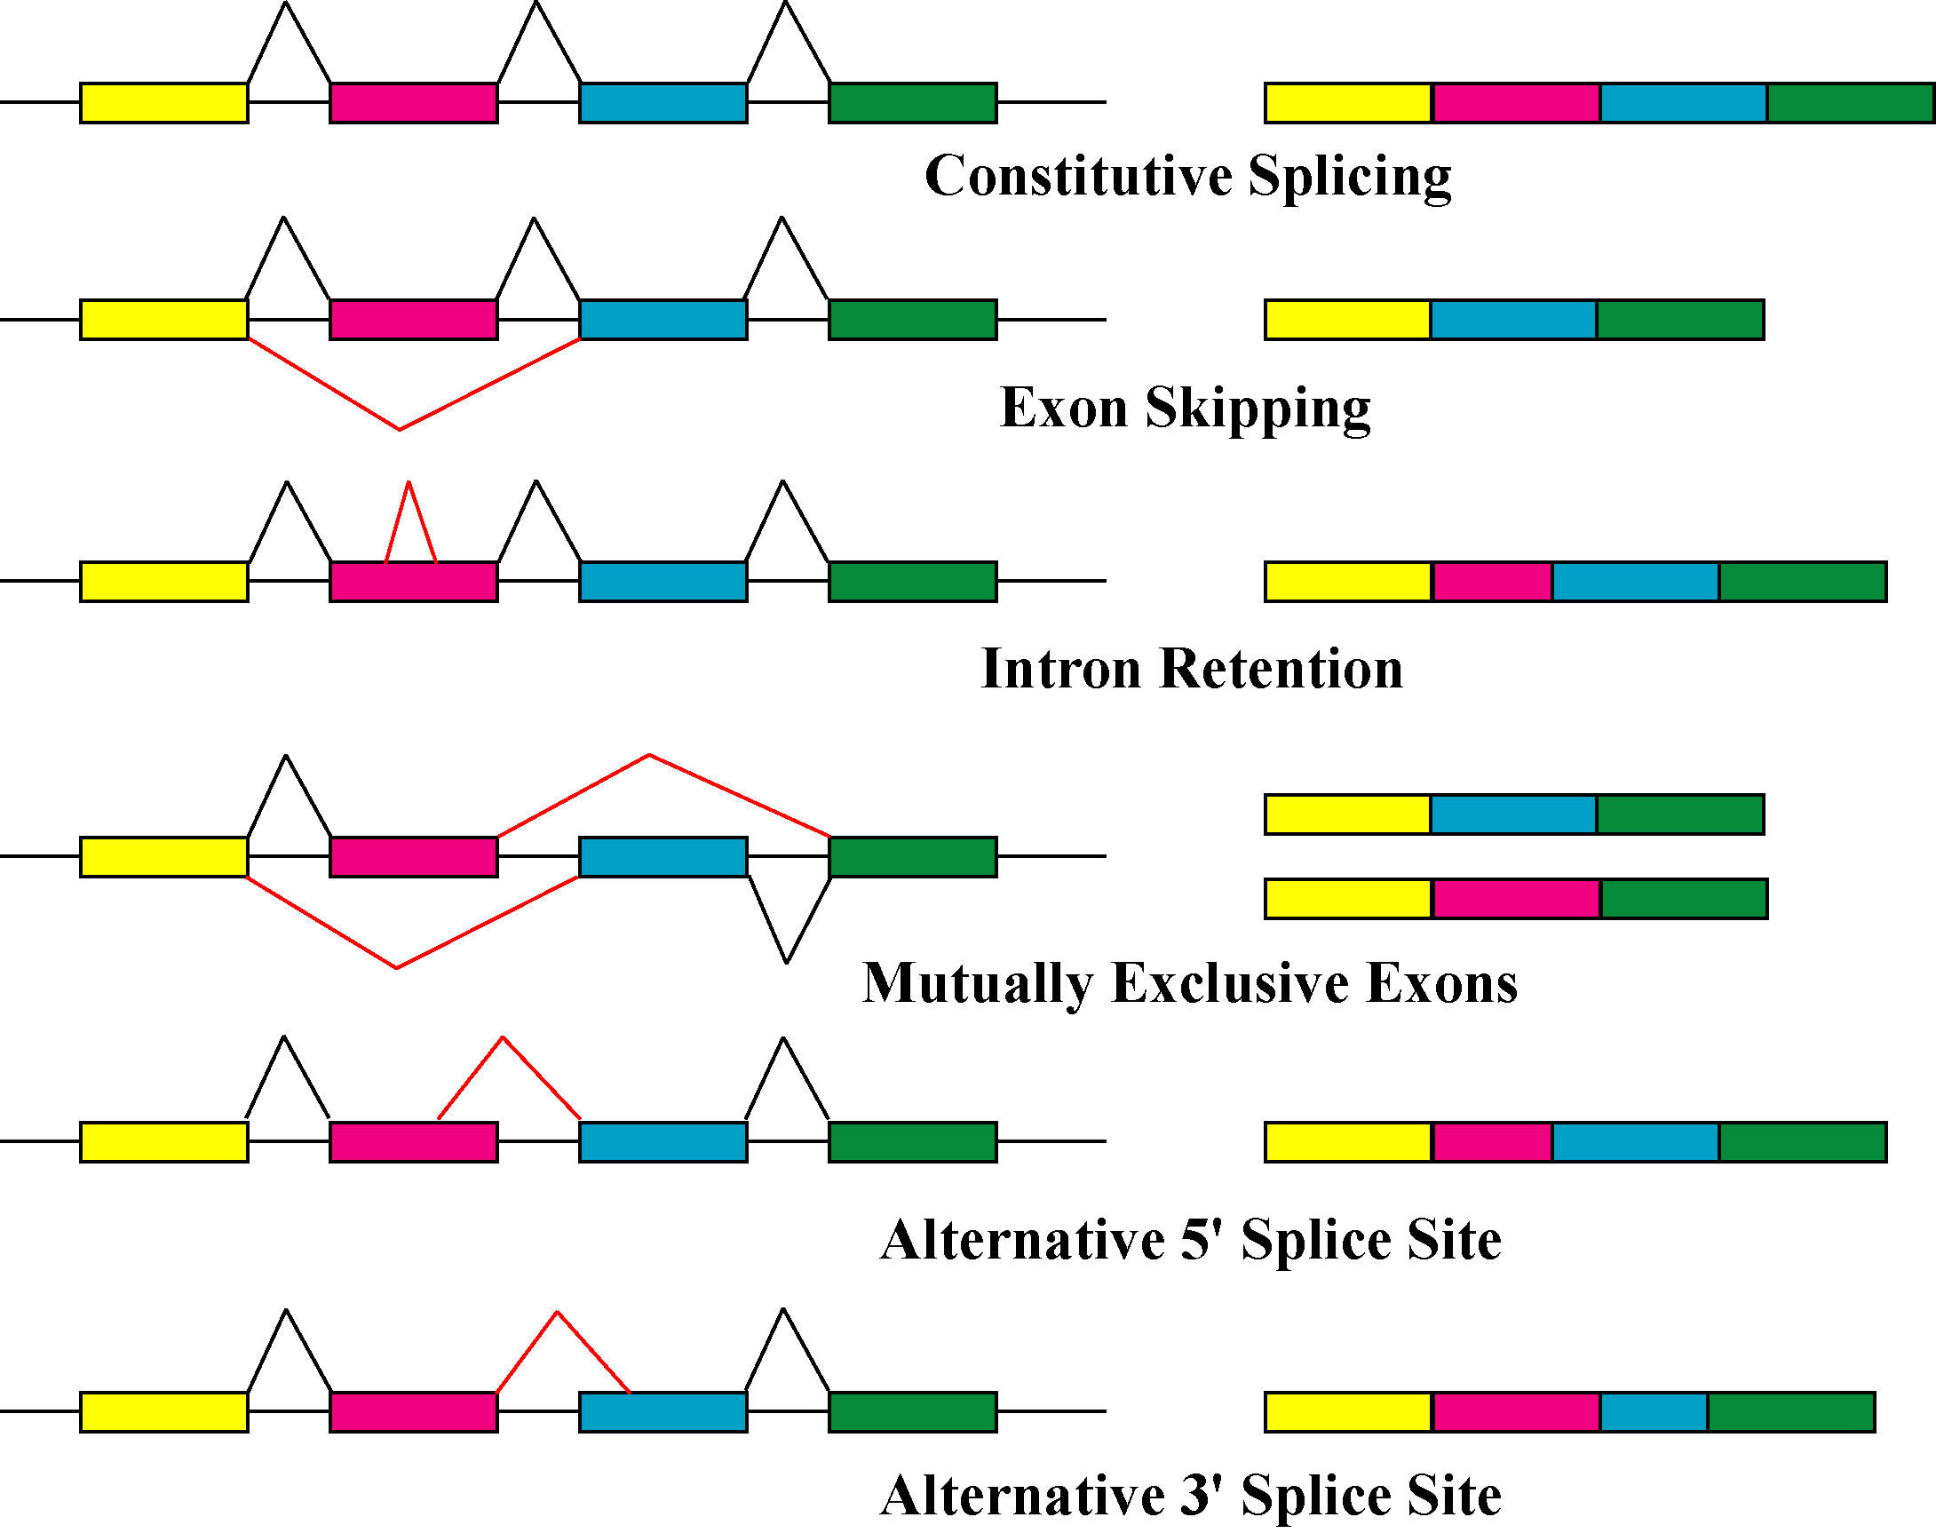
Alternative Splicing
Image from Jan Medenbach, CC BY-SA 2.0 DE <https://creativecommons.org/licenses/by-sa/2.0/de/deed.en>, via Wikimedia Commons

Slide 13
3’ Poly-A Tail Addition
The final step of processing is the addition of a long (~200 nucleotides) series of adenosine nucleotides to the 3’ end of the RNA molecule
Added by a special poly-A polymerase (PAP) that does not require a template
Allows the cell to “know” that the 3’ end of the RNA is intact, and also may help regulate the stability of the RNA molecule
PAP
5’
AAAAAAAAAAAAAAAAAAAAAAAA
3’
mRNA

Slide 14
Other RNA Molecules
There are many other RNA molecules in the cell that do not encode proteins (only about 5% of eukaryotic RNAs are mRNA)
These include RNAs that are important for mRNA splicing (snRNA), protein translation (rRNA, tRNA), DNA replication (hTR), and other functions
In bacterial cells, all RNA molecules are synthesized by the same RNA polymerase enzyme
In eukaryotic cells, most non-mRNAs are transcribed by different RNA polymerase enzymes than the one that transcribes mRNA, and they are often also processed very differently

Slide 15
Next Lecture: Protein Translation

