Slide 1
Jerusalem Science Contest
Molecular Biology

Slide 2
Proteins Perform Most Cellular Functions
Proteins comprise ~50% of the dry weight of a cell, making them the most abundant type of molecule in cells
This reflects the fact that proteins perform the majority of activities in the cell, including structural, metabolic, transport, and communication functions
As a result, proteins are also extremely diverse, with a wide range of sizes, structures, and chemical properties

Slide 3
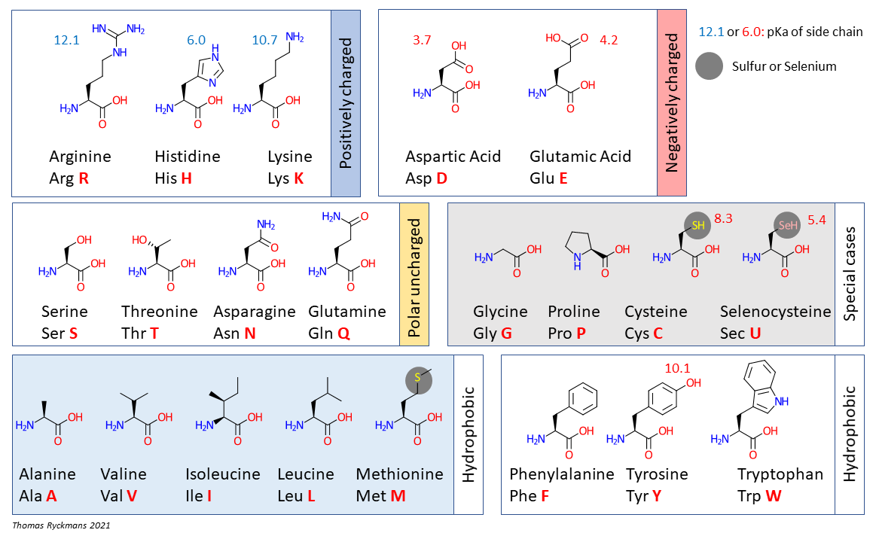
Proteins Are Composed of Amino Acids
Like DNA and RNA, proteins are polymers
The monomer subunits for proteins are amino acids
There are 20 amino acids that are found in essentially all proteins (and a 21st that is in a smaller subset)
Each amino acid has unique chemistry that is important for protein structure and function
Image from Thomas.ryckmans68, CC BY-SA 4.0 <https://creativecommons.org/licenses/by-sa/4.0>, via Wikimedia Commons

Slide 4
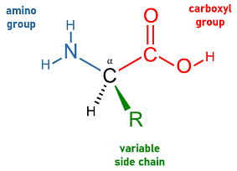
Structure of Amino Acids
All amino acids have a core “backbone” structure of three components:
A central carbon atom (called the “α carbon”)
An amine group (-NH₂) attached to the α carbon
A carboxylic acid group (-COOH) attached to the α carbon
Two additional pieces are a hydrogen atom and a variable side chain (-R), both attached to the α carbon
The variable side chain imparts the unique chemical characteristics of each amino acid
Image from PJsg1011, CC BY-SA 4.0 <https://creativecommons.org/licenses/by-sa/4.0>, via Wikimedia Commons

Slide 5
Structure of Amino Acids
Like nucleotides, amino acids (and proteins) have directionality
The amino group is on one side (“N terminus”) and the carboxylic acid group is on the other side (“C terminus”)
Proteins are synthesized by linking the amino group of a monomer amino acid to the carboxylic acid group at the end of a growing chain (called a “polypeptide”).
Thus, synthesis occurs in the N->C direction

Slide 6
The Genetic Code
The sequence of a protein is encoded by the nucleotide sequence of mRNA (and therefore by the nucleotide sequence of DNA)
Each amino acid is encoded by a 3-nucleotide sequence called a codon
Work to decode the entire genetic code was largely performed by Marshall Nirenberg and Har Gobind Khorana working separately and using artificial RNA molecules (they shared the 1968 Nobel Prize for their work)
Of the 64 possible codons, 61 are used to encode the 20 common amino acids, and 3 are special “stop codons” that indicate the end of the protein sequence (selenocysteine does not have a dedicated codon)

Slide 7
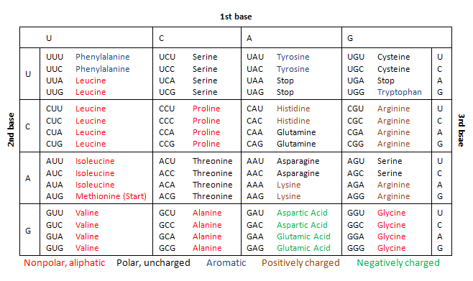
The Genetic Code
Image from Dave15o1, Public domain, via Wikimedia Commons

Slide 8
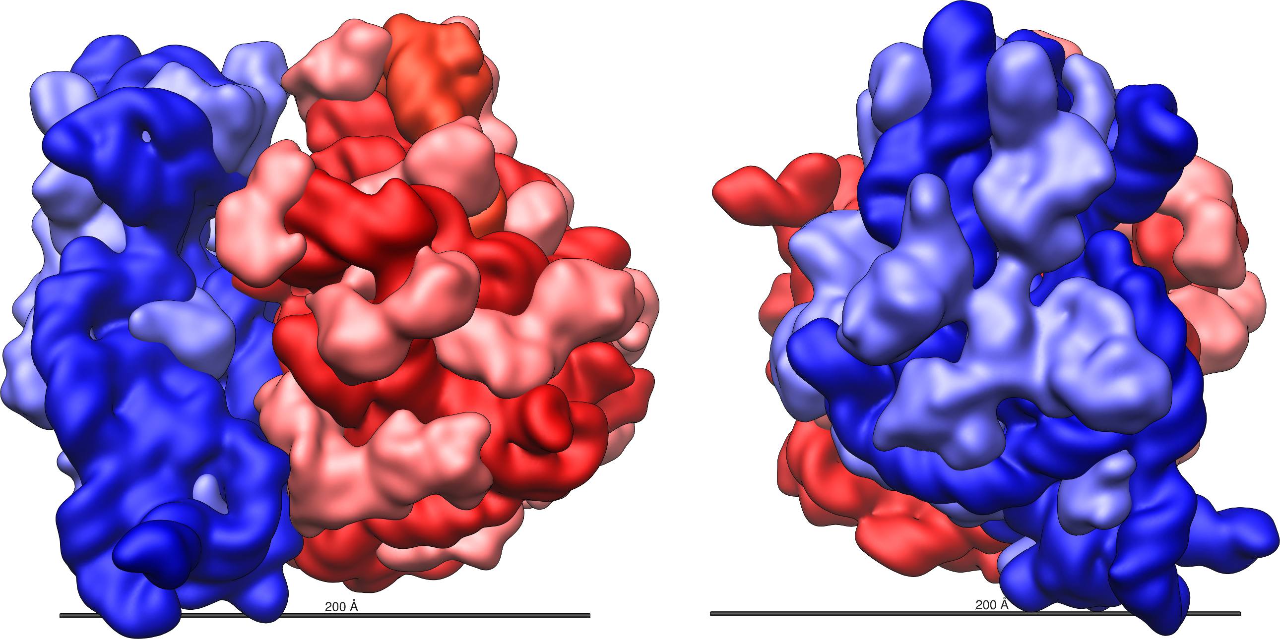
Protein Translation
The process of decoding mRNA molecules to synthesize proteins is called translation.
Translation is performed by a complex molecular machine called the ribosome.
It is composed of two subunits (the “large” and “small” subunits), each of which contains RNA molecules (3 total in bacteria, 4 total in eukaryotes) combined with many proteins (52 total in bacteria, 82 total in eukaryotes)
Image from Vossman, CC BY-SA 3.0 <https://creativecommons.org/licenses/by-sa/3.0>, via Wikimedia Commons

Slide 9
Protein Translation
Translation starts when the small subunit of the ribosome binds to the 5’ end of a mRNA. In eukaryotes, the 5’ cap serves as the ribosome binding site.
The small subunit scans along the mRNA until it reaches an “initiation” codon, which is almost always AUG, encoding methionine
The large subunit then attaches and begins linking amino acids together, moving in the 5’->3’ direction, one codon at a time

Slide 10
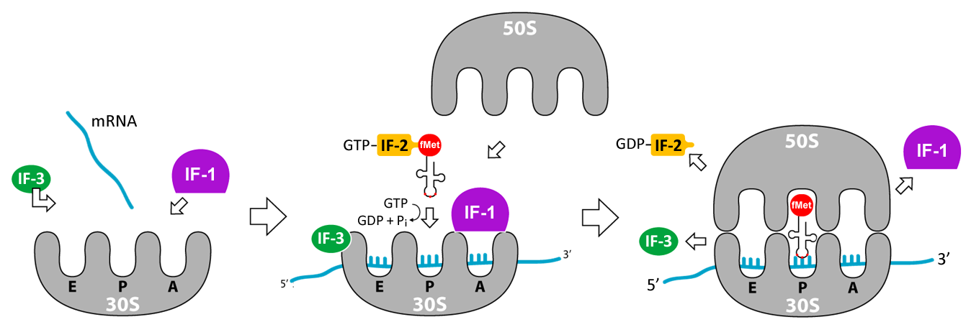
Translation Initiation
Image from User07, CC BY-SA 3.0 <http://creativecommons.org/licenses/by-sa/3.0/>, via Wikimedia Commons

Slide 11
Transfer RNA: Translating the Code
A big problem for translation is that there is no “complementarity” between amino acids and nucleotides, unlike DNA and RNA
This means that help is needed to match each amino acid to its codon(s)
This decoding function is performed by transfer RNA (tRNA) molecules

Slide 12
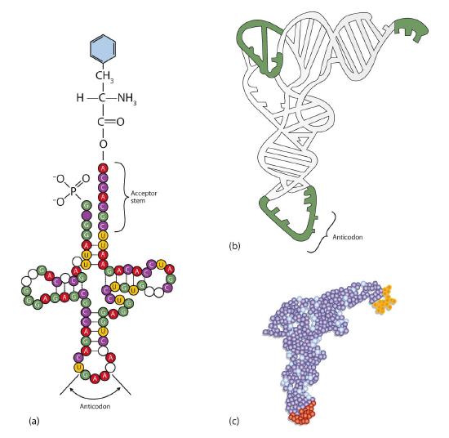
tRNA
Transfer RNA are short RNA molecules with a distinctive 3D structure
An amino acid is covalently bound to the 3’ end of the molecule, and the middle of the RNA contains a 3-nucleotide sequence complementary to the codon (“anticodon”)
The tRNA brings the correct amino acid to the ribosome during translation
Image from unknown author, CC BY-SA 4.0 <https://creativecommons.org/licenses/by-sa/4.0>, via Wikimedia Commons

Slide 13
Translating the mRNA
Once the ribosome has assembled at the initiation codon, it begins adding new amino acids at the C-terminus of the growing chain
The existing chain remains covalently bound to the last tRNA that came in.
A new tRNA carrying an amino acid enters the ribosome and the anticodon pairs with the next available codon in the mRNA
If it matches, the ribosome transfers the entire chain to the amino group of the new amino acid, releasing the old tRNA
The ribosome then moves forward one codon (3 nucleotides) and repeats the process

Slide 14
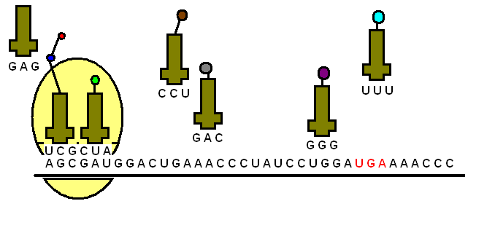
Translating the mRNA
Image from Lenam14, CC BY-SA 3.0 <https://creativecommons.org/licenses/by-sa/3.0>, via Wikimedia Commons

Slide 15
Translational Termination
The ribosome needs to know where to stop translating
3 of the 64 codons indicate the end of the protein: “stop” codons
These codons do not encode any amino acids, and have no associated tRNA
Instead, they bind to small proteins called release factors, which cause the peptide chain to be cleaved from the last tRNA, and the ribosome subunits to release the mRNA

Slide 16
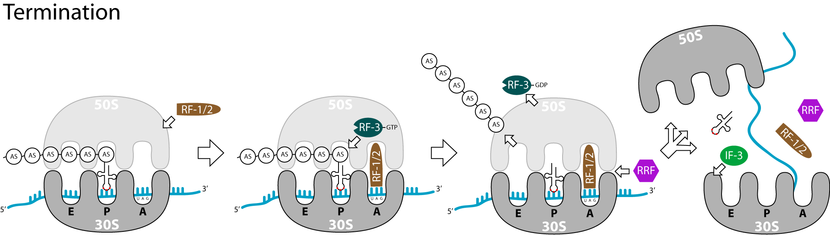
Translation Termination
Image from User07, CC BY-SA 3.0 <http://creativecommons.org/licenses/by-sa/3.0/>, via Wikimedia Commons

Slide 17
Next Lecture: Genetic Engineering and Gene Therapy

